Slide 1
Personal Information Management & Sharing

Slide 2
TWO SCENARIOS
TO CONSIDER
  Does your family really know what to do if you die or become incapacitated?
  Do you really know what to do if your parent or family member dies or becomes incapacitated?
  Let’s drill a little deeper

Slide 3
DOES YOUR FAMILY REALLY KNOW WHAT TO DO
IF YOU DIE OR BECOME INCAPACITATED?
Instructions?
Access to online/offline accounts?
Access to your will or trust?
If no trust, are they ready to face the time & expense of probate?
If incapacitated, do they know your healthcare needs?
If a caretaker, do they know your charge’s healthcare needs?

Slide 4
DO YOU REALLY KNOW WHAT TO DO IF YOUR PARENT OR FAMILY MEMBER DIES OR BECOMES INCAPACITATED?
Instructions?
Access to online/offline accounts?
Access to your will or trust?
If no trust, are they ready to face the time & expense of probate?
If incapacitated, do they know your healthcare needs?
If a caretaker, do they know your charge’s healthcare needs?

Slide 5
TODAY’S SESSION
WILL COVER THE FOLLOWING
  Using & sharing a Personal Information Management Tool
  Using & sharing a File Management Repository
  Using & sharing a Family Password Management App

Slide 6
A PRACTICAL APPLICATION
I have been remotely managing my Texas-based 80-year-old uncle’s and my 89-year-old dad and his wife’s accounts using a Family Password Manager
I share an online personal management tool with my husband, kids, and trustee
I have set up tools for my sisters to help them manage their personal information
I share pictures with family via OneDrive
I share important documents via Google Drive

Slide 7
  1. PERSONAL INFORMATION MANAGEMENT TOOLS
There are a few task management or Kanban style apps you can use. Our family has used Trello, but have recently designed our own spreadsheet app, as bolded below:
APPS
Trello (free)
Monday.com
Spreadsheets | Excel Desktop or 365 Excel Online (free) Google Sheets (free)
Docs | Word Desktop or 365 Word Online (free) Google Docs (free)

Slide 8
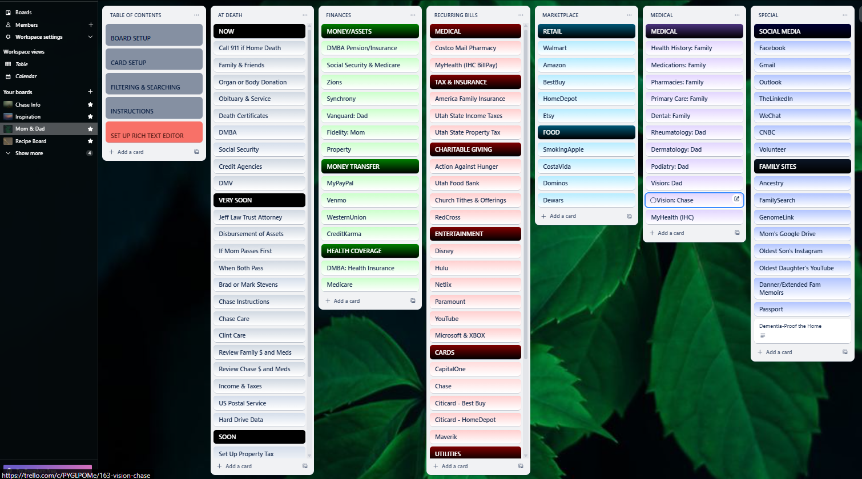

Slide 9
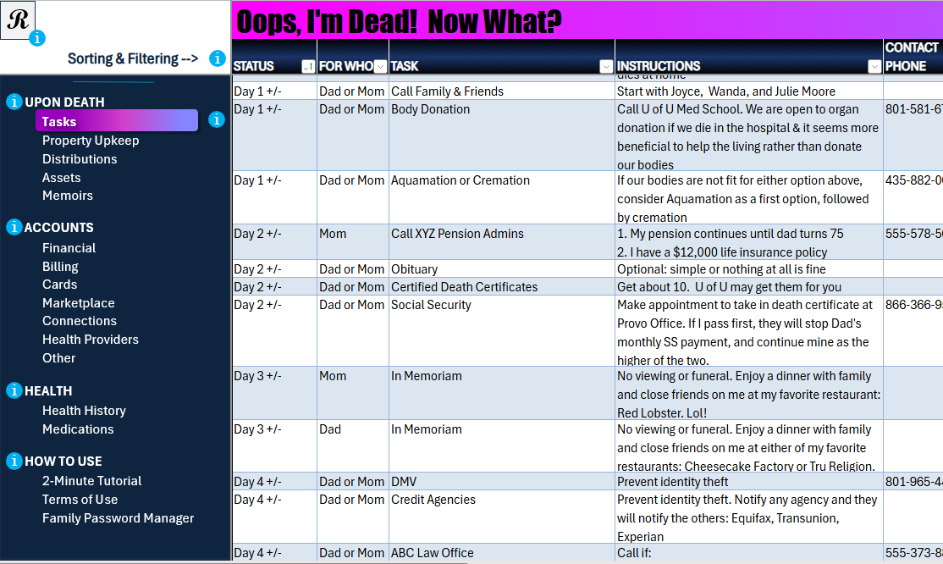

Slide 10
2. FILE MANAGEMENT REPOSITORIES
With the advent of the cloud, consider managing and sharing your documents, pictures, video, and other items in apps like the following:
  OneDrive
    https://www.microsoft.com/en-us/microsoft-365/onedrive/compare-onedrive-plans
  Google Drive
  https://one.google.com/about/plans?g1_landing_page=0
  iDrive

Slide 11
3. FAMILY PASSWORD MANAGERS
Various App Options
Below are a few password management apps that are designed for families. Do some research, give a few a trial run, and choose the one that works best for you; however, this presentation will focus on 1Password since it’s the app we’re familiar with and the only one we’ve ever used.
PASSWORD MANAGEMENT APPS FOR FAMILIES
1Password (about $60 yr or $12 yr per family) | Proton Pass
LastPass | Bitwarden
RoboForm | Nordpass
And there are a few others . . .

Slide 12
3. FAMILY PASSWORD MANAGERS
1Password Features
Family Plan of 5 users, with minimal charge for additional users
Allows for individual and shared vaults
Can be used to store secure info beyond just passwords
Watchtower section shows:
  Password strength (16 characters: U/L Case, numbers, special characters)
  Sites that provide Passkeys and 2-Factor Authentication

Slide 13
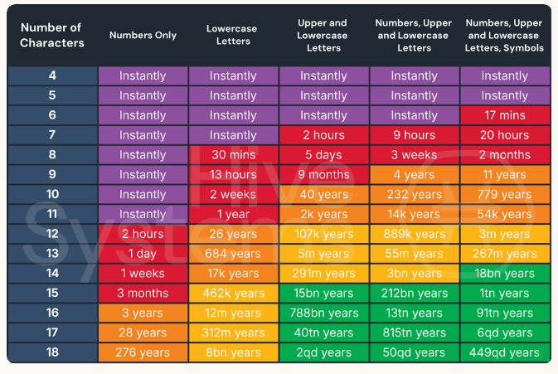
ABOUT PASSWORD STRENGTH
How quickly a hacker with a number of tools at their disposal can crack your password
https://www.hivesystems.com/blog/are-your-passwords-in-the-green

Slide 14
3. FAMILY PASSWORD MANAGERS
1Password Item Types
Besides creating and sharing login info for all your accounts using the Login item type, you can also store data for the Item Types shown in the table below. And, you can add Tags to Item Types – both of which can be used to filter your list of Item Types in the app.
TYPES WE USE OFTEN |  |  | OTHER AVAILABLE TYPES
Login | Document (attachments) |  | Email Account | SSH Key
Identity | Passport |  | Password | Server
Credit Card | Social Security # |  | Membership | Crypto Wallet
Bank Account | Wireless Router |  | Outdoor License | Database
Driver License | Secure Note |  | Reward Program | Software License
 |  |  | API Credential

Slide 15
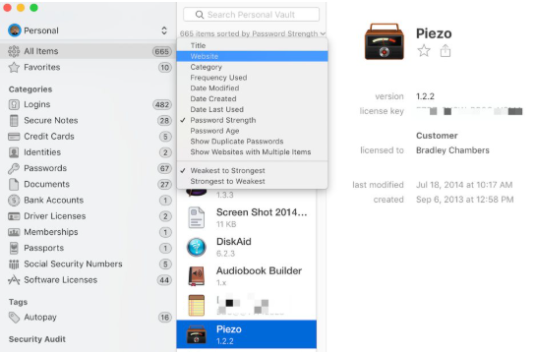
3. A FAMILY PASSWORD MANAGERS
Workspace
The 1Password workspace has 3 key sections
AREA | DATA
Left | Vaults & Tags
Middle | List of Items Dropdown to filter by Category
Right | Item Details/Editing

Slide 16
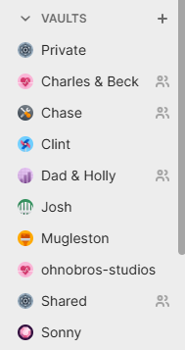
3. FAMILY PASSWORD MANAGERS
1Password Vaults
You can create vaults, share them with the appropriate user(s), and store the appropriate Item Types within those vaults. If other users on the family have created vaults to which you’re not assigned, those vaults do not appear on the list at left.
VAULT | ACCOUNTS FOR . . . | SHARED WITH . . .
Charles & Beck | Husband & I | Our executor daughter
Dad & Holly | My dad and his wife | Dad’s wife, my sister, & me
son-studios | Son’s business | My son & me
Sonny | My Uncle in TX | My uncle, my sister, & me

Slide 17
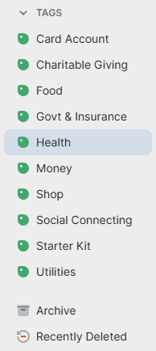
3. FAMILY PASSWORD MANAGERS
Tags
Adding Tags to the Items you add to your vault will allow you to filter your Item List by those tags. For example, if I click on the Utilities tag at right, my Item List will be filtered to show only accounts that have been tagged Utilities.

Slide 18
USING & SHARING YOUR INFORMATION
OFFLINE RATHER THAN ONLINE
Use page protectors to store the following key documents in a binder in a fireproof box or other safe area:
Certified Birth Certificates
Certified Marriage Certificates
Social Security Cards
Passports
Revocable Trusts
Last Will & Testaments
Power of Attorneys
Advance Health Care Directives
Deeds (Home, Auto, etc.)
Loan Documents
Warranties

